Slide 1
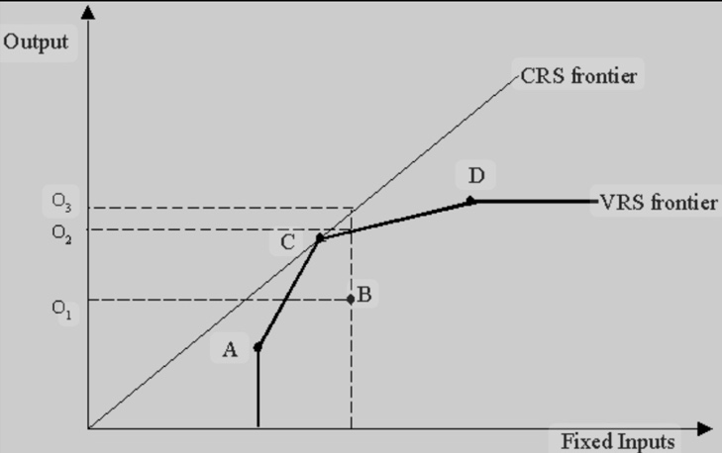

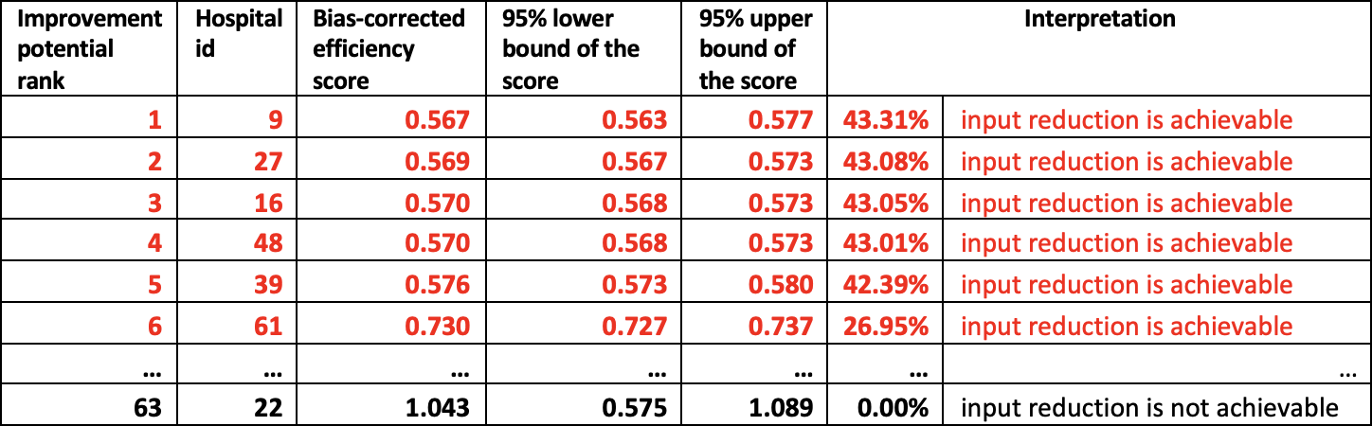
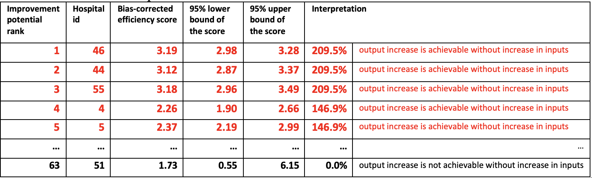

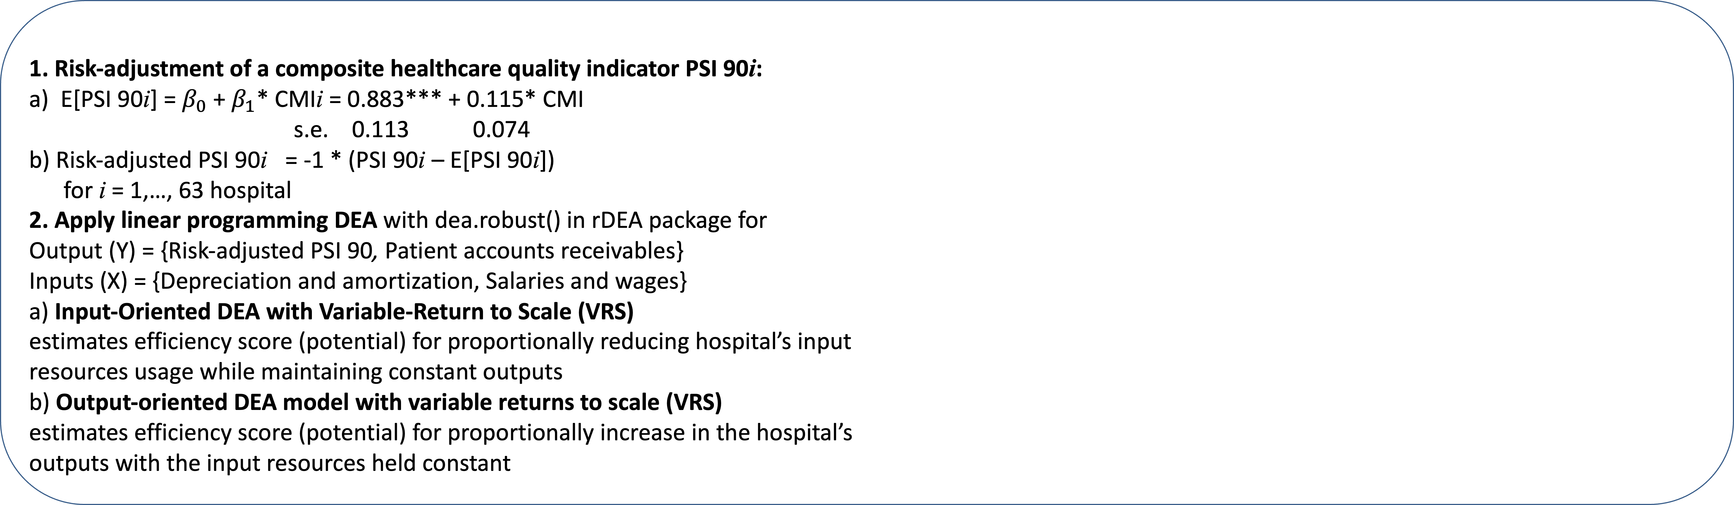
#63. Application of the Data Envelopment Analysis (DEA) to decision-making on labor and capital investment in the US hospitals
Eugene Yankovsky, MSc in Stats & Econ (Eugene.Yankovsky@ProfeSci.com)
1. Risk-adjustment of a composite healthcare quality indicator PSI 90i:
a) E[PSI 90i] = $β_{0}$ + $β_{1}$* CMIi = 0.883*** + 0.115* CMI
s.e. 0.113 0.074
b) Risk-adjusted PSI 90i = -1 * (PSI 90i – E[PSI 90i])
for i = 1,…, 63 hospital
2. Apply linear programming DEA with dea.robust() in rDEA package for
Output (Y) = {Risk-adjusted PSI 90, Patient accounts receivables}
Inputs (X) = {Depreciation and amortization, Salaries and wages}
a) Input-Oriented DEA with Variable-Return to Scale (VRS)
estimates efficiency score (potential) for proportionally reducing hospital’s input
resources usage while maintaining constant outputs
b) Output-oriented DEA model with variable returns to scale (VRS)
estimates efficiency score (potential) for proportionally increase in the hospital’s
outputs with the input resources held constant
BACKGROUND
METHODS
Minimize input resources usage while maintaining constant output levels:
Can the hospital maintain the same level of quantity and quality of the healthcare with less resources used?
Maximize output with resources inputs held constant:
Does the hospital have any efficiency reserves to increase quantity and quality of healthcare without extra investment into the labor and capital?
DATA
RESULTS & CONCLUSIONS
Input variables (X) at the hospital level
Patient’s Case Mix Index (CMI)
Depreciation and amortization
Salaries and wages
Output variables (Y) at the hospital level
Risk Adjusted Composite healthcare quality indicator PSI 90 (source: Centers for Medicare and Medicaid Services)
Patient accounts receivables (source: Maryland Health Services financial statements)
All hospitals in the sample are ranked by their potential to reduce labor
and capital expenses without reduction of quantity and quality of the
healthcare that varied in the range between 0.09% to 43.31%
All hospitals in the sample are ranked by their potential to increase
the healthcare quantity and quality without increase in labor and capital
investment that varied from 0.03% to 209.5%
Risk-adjusted DEA is an effective method for evaluating hospital performance
relative to peers and identifying opportunities for optimizing resource utilization
See all details in the paper via the QR code

